Slide 1
Libcs and where to find them
By k4lizen

Slide 2
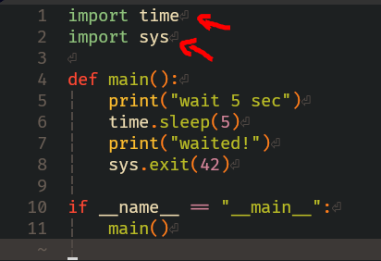
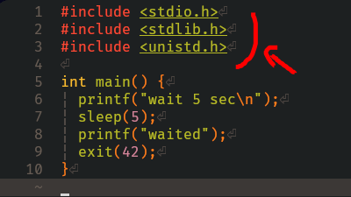

What is a libc?
Add tag
Add tag
Add tag
An implementation of the C standard LIBrary!
Every programming language generally has a standard library that comes with it e.g.
https://docs.python.org/3/library/index.html
https://doc.rust-lang.org/std/
https://ziglang.org/documentation/master/#Zig-Standard-Library
Banger read: https://faultlore.com/blah/c-isnt-a-language/

Slide 3
Why do we need a standard library?
Add tag
Add tag
Add tag
What does programming without a standard library (stdlib) look like?
Banger read: https://faultlore.com/blah/c-isnt-a-language/

Slide 4
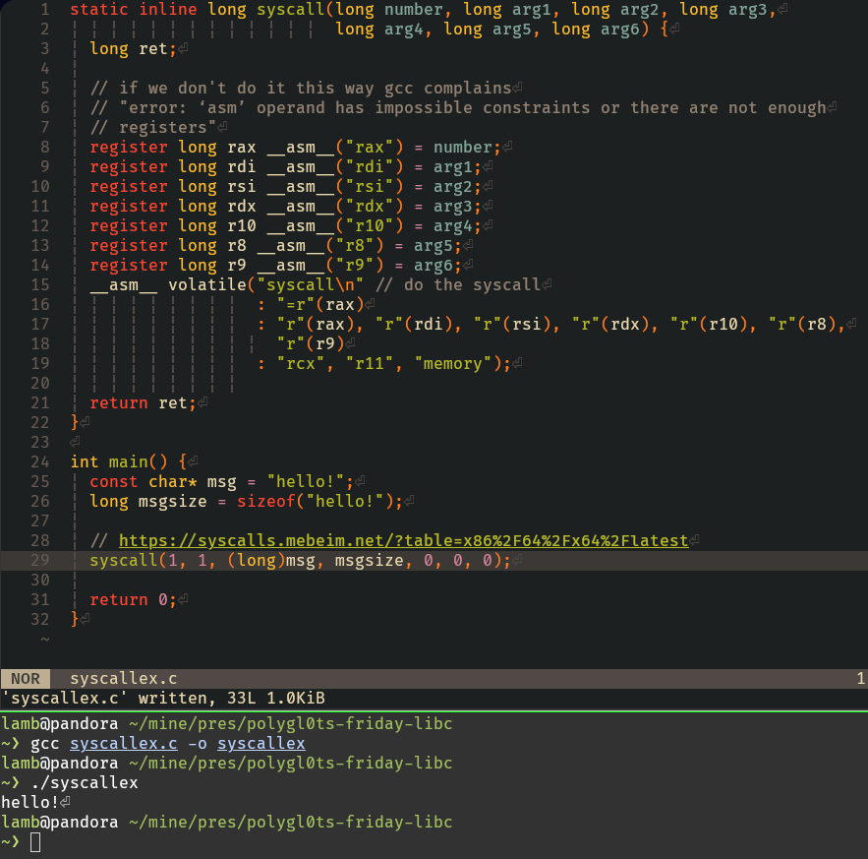

Add tag
Add tag
Add tag
Notice no imports at the top!
`man 2 write`
https://syscalls.mebeim.net/
Not too bad!
Let’s do the example from before!
Oh…

Slide 5
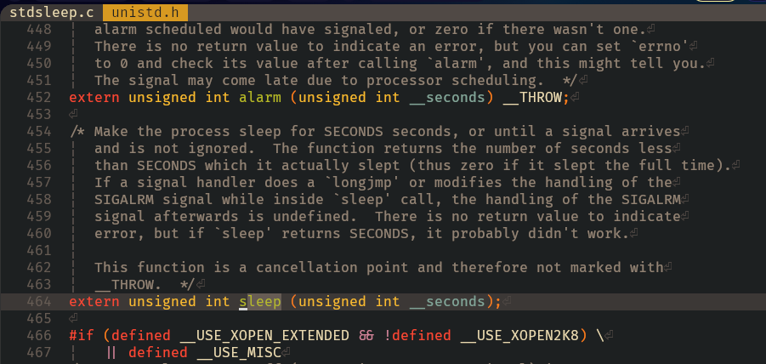
Side-quest: Find a libc implementation of sleep()
Add tag
Add tag
Add tag
Love-hate relationship with go-to-definition.

Slide 6
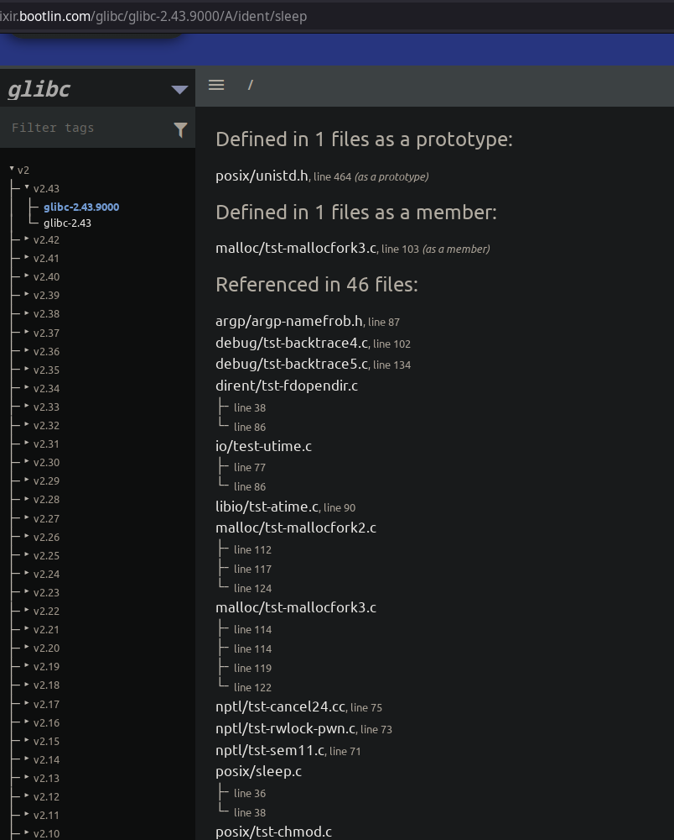
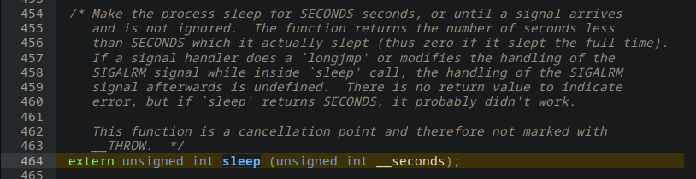


Side-quest: Find a libc implementation of sleep()
Add tag
Add tag
Ahh.
https://elixir.bootlin.com/glibc/glibc-2.43.9000/A/ident/sleep
The definition is pointed out!
Requires some brain power.

Slide 7
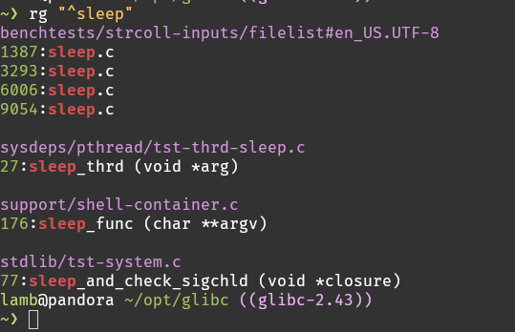
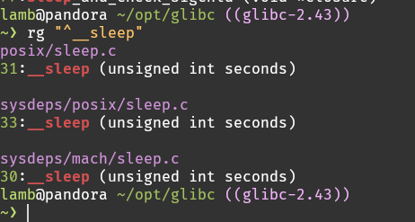
Side-quest: Find a libc implementation of sleep()
Add tag
Add tag
The power of the GNU style, easy greppability!
Oh…
Guess-god-ing our way to victory.

Slide 8
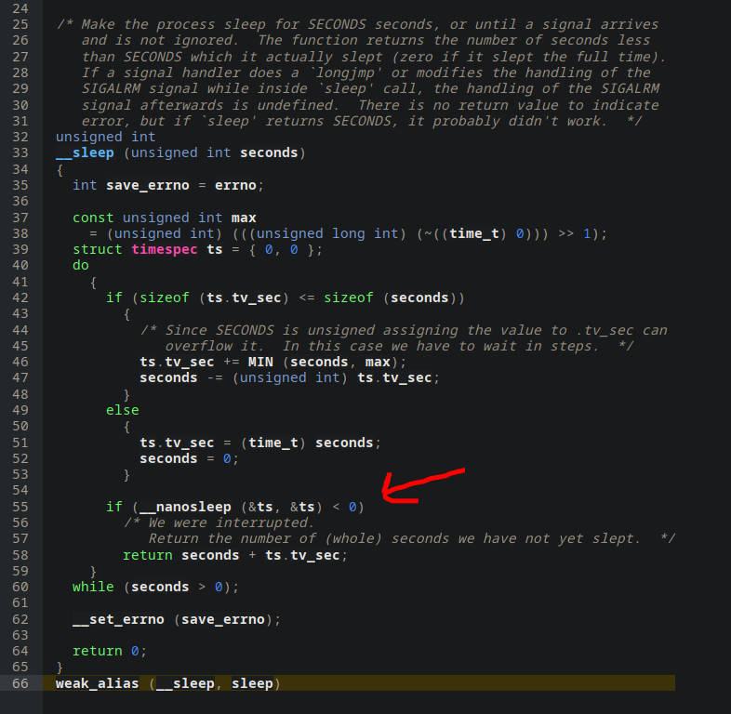
Side-quest: Find a libc implementation of sleep()
Add tag
Add tag
`man 2 nanosleep`
Yay!

Slide 9
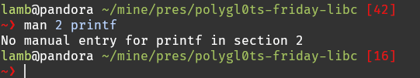
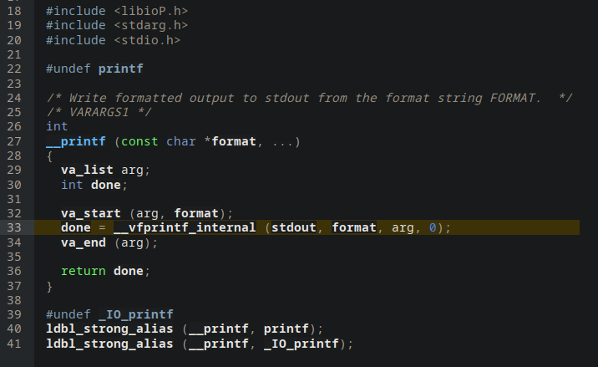
What about printf()?
Where is __vfprintf_internal defined??
Fuck it, open up gdb.
Add tag

Slide 10
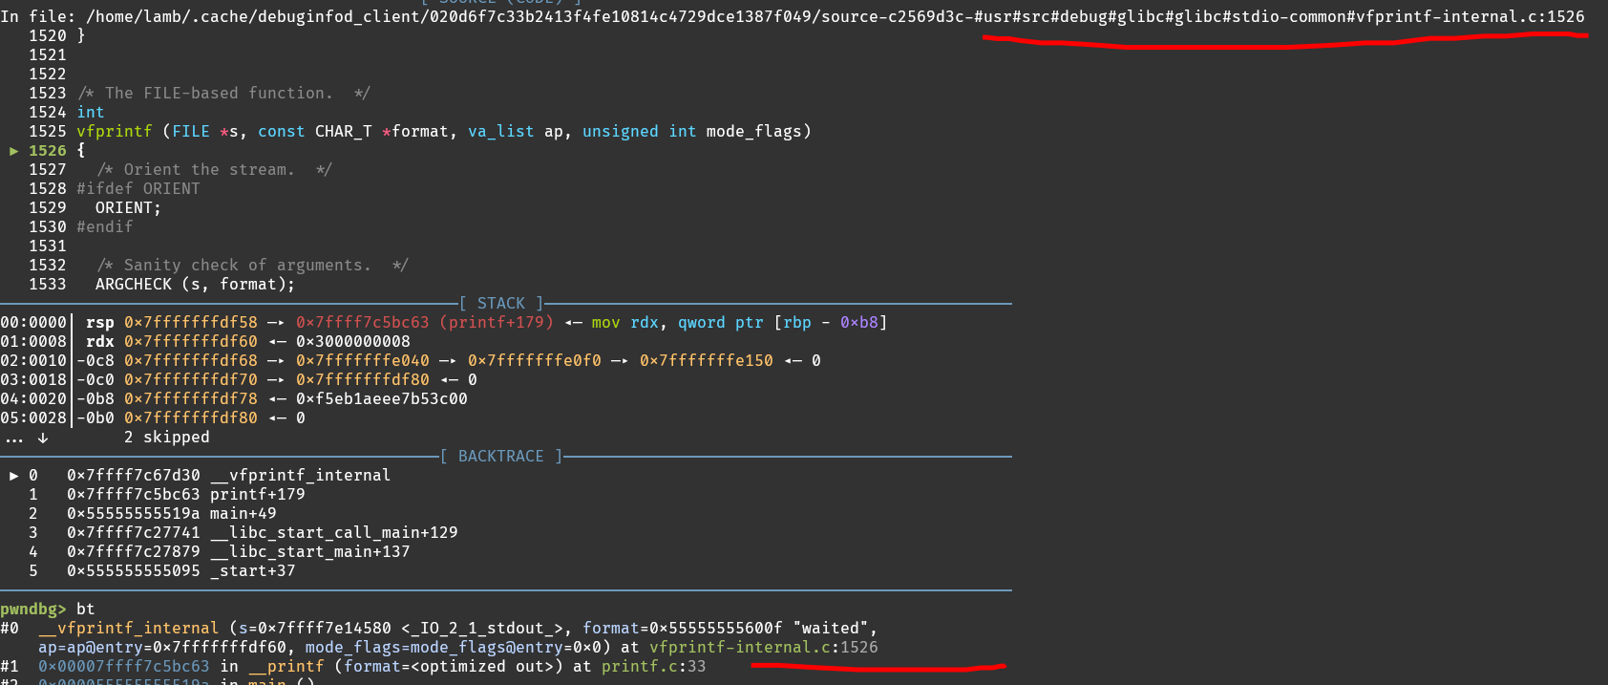
What about printf()?
Add tag

Slide 11
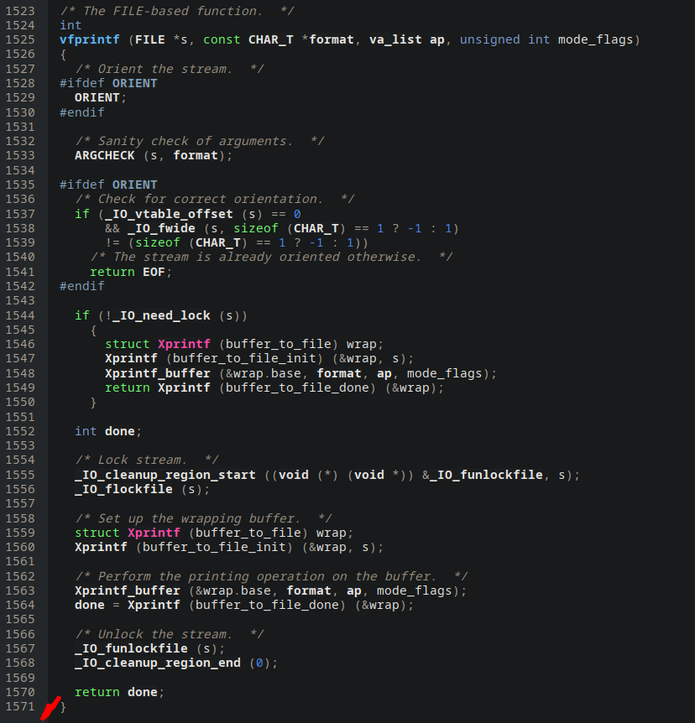
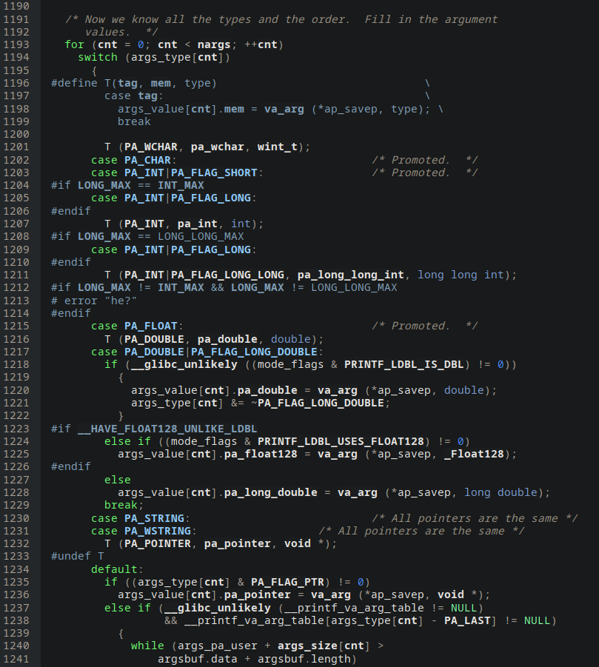
What about printf()?
Add tag
You don’t want to be the one writing this.

Slide 12
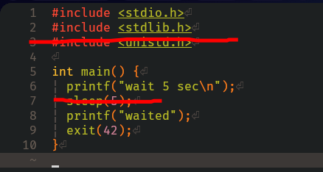
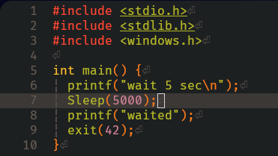
Why do we need a standard library?
Add tag
Add tag
Add tag
What does programming without a standard library (stdlib) look like?
Not good!
Portability? Will it work on windows?
Kinda?
Some languages try harder than others :)

Slide 13
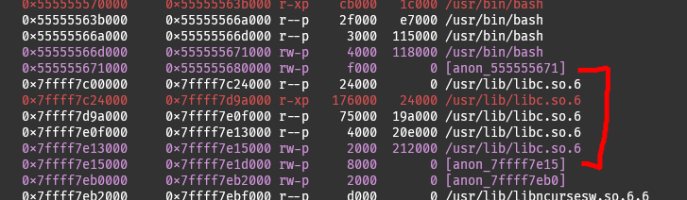
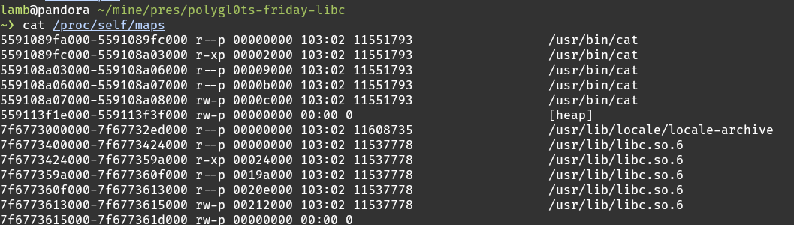
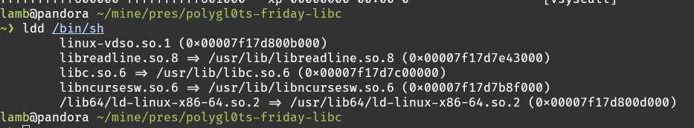
Where is the standard library?
Add tag
Add tag
Add tag

Slide 14
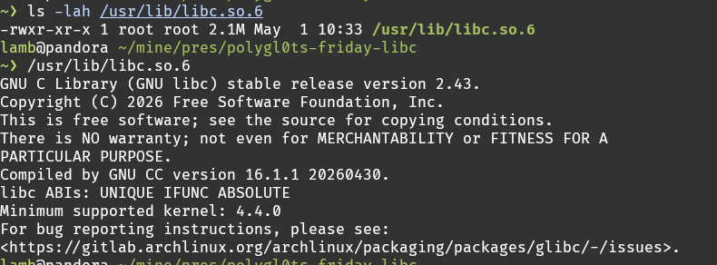
Where is the standard library?
Add tag

Slide 15
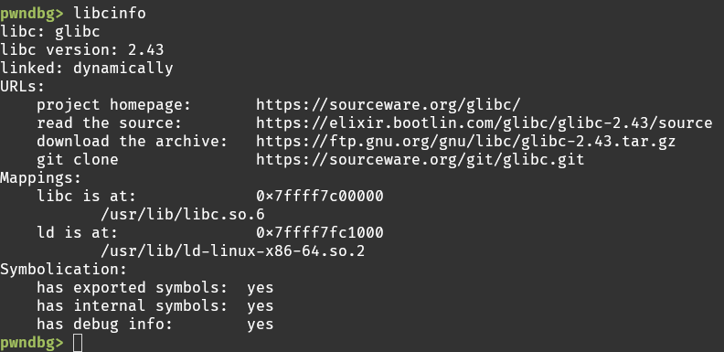
Where is the standard library?
Add tag

Slide 16
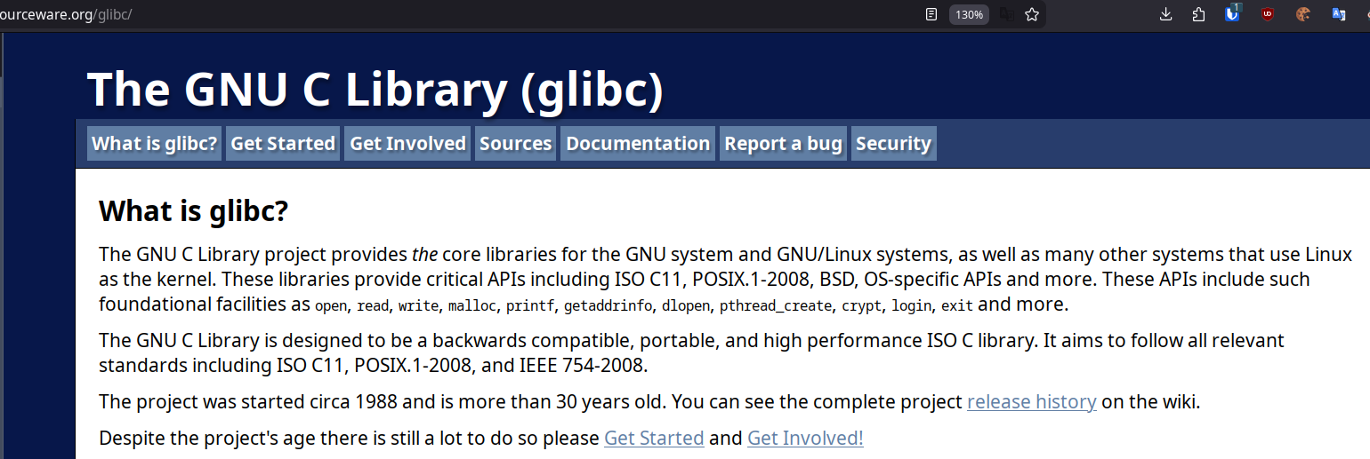
Where is the standard library?
Add tag
The implementation that you’re probably using is the one by GNU!

Slide 17
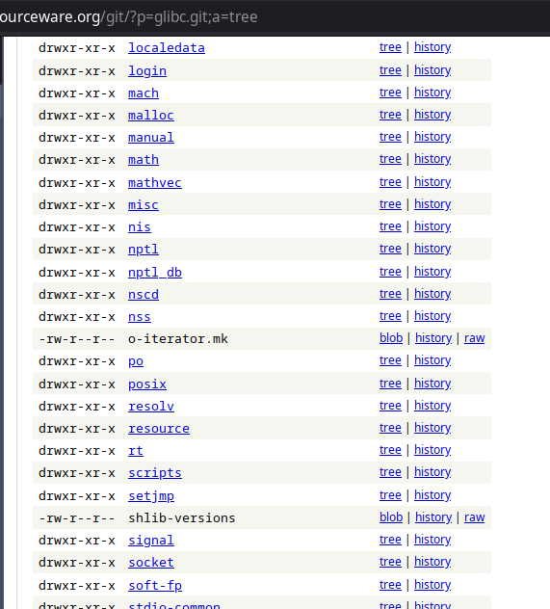
Where is the standard library?
Add tag
https://sourceware.org/git/?p=glibc.git;a=tree

Slide 18
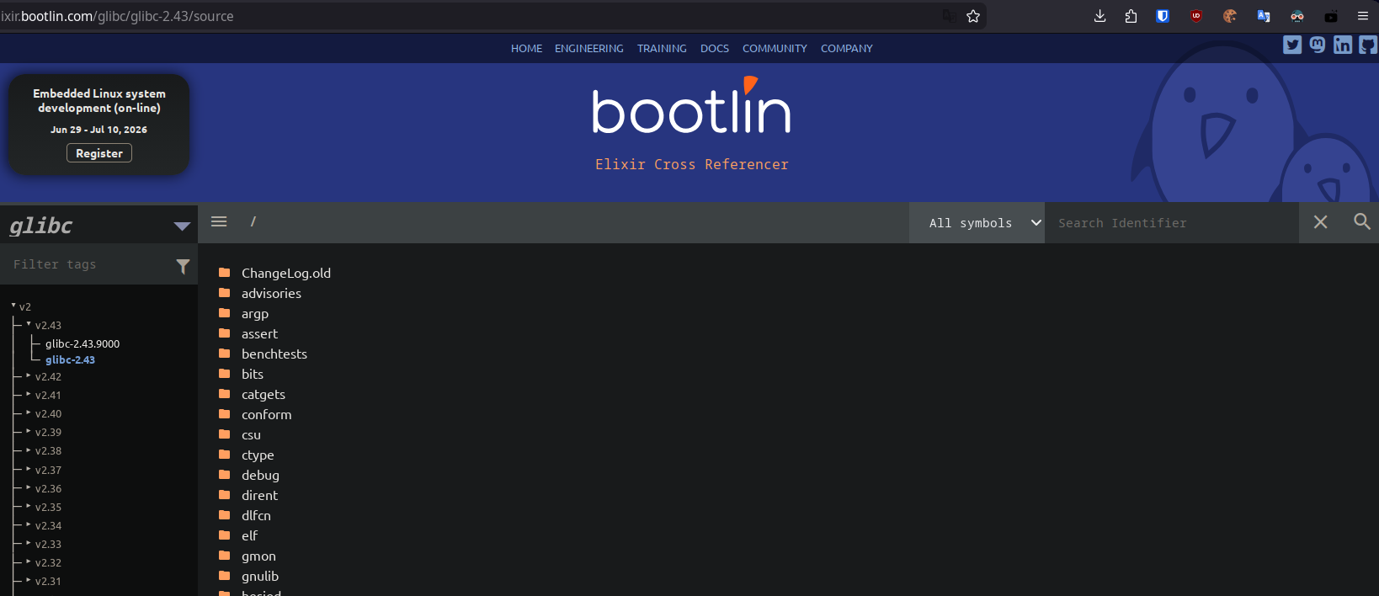
Where is the standard library?
Add tag
https://elixir.bootlin.com/glibc/glibc-2.43.9000/source

Slide 19
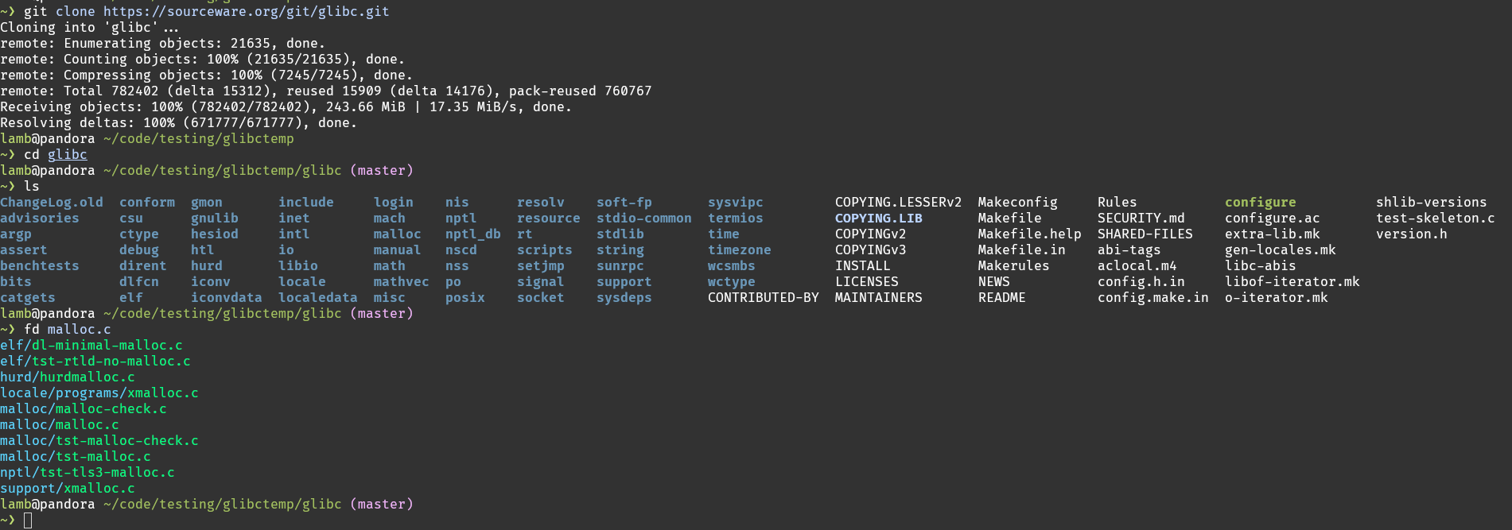
Where is the standard library?
Add tag
By far the best if it’s in your editor! –- Always clone the code you read, and get good at using your editor!

Slide 20
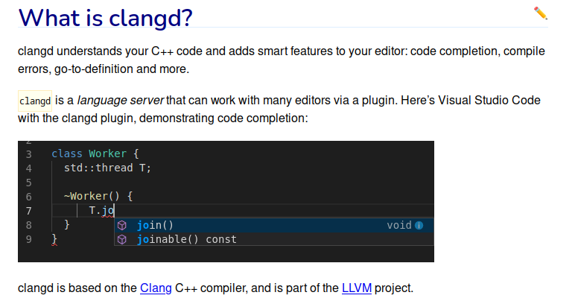
Reading the standard library.
Add tag
You *need* go-to-definition and go-to-references. It is insanely good quality of life, and a very good speedup.
Some Integrated Development Environments (IDEs) will handle this for you, but the “manual” way (what they all do in the backend, and what you should be doing because IDEs are kinda bad at resolving C references):
https://clang.llvm.org/docs/JSONCompilationDatabase.html
https://github.com/rizsotto/Bear

Slide 21
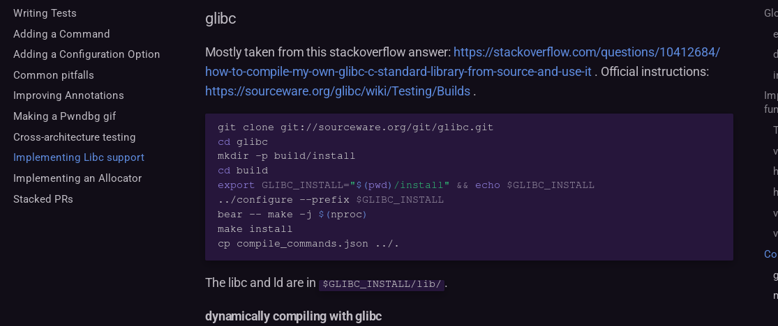
Compiling the standard library (glibc).
Add tag
Need to compile the project with a wrapper tool (for example `bear`), to produce a `compile_commands.json` file which clangd will consume in order to give you go-to-definition etc.
I wrote some docs for compiling libc’s for pwndbg: https://pwndbg.re/dev/contributing/libc-provider/#glibc

Slide 22
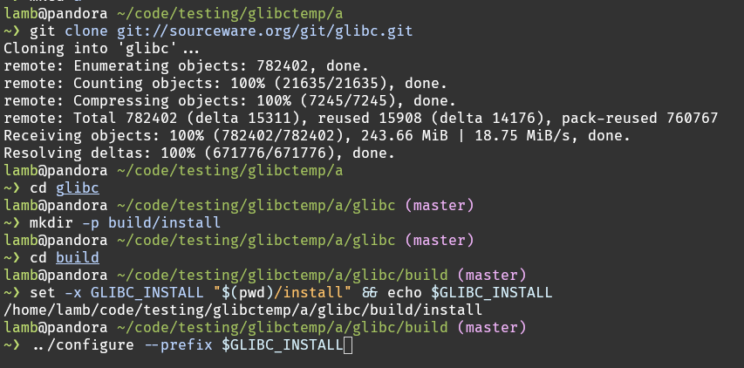
Compiling the standard library (glibc).
Add tag

Slide 23
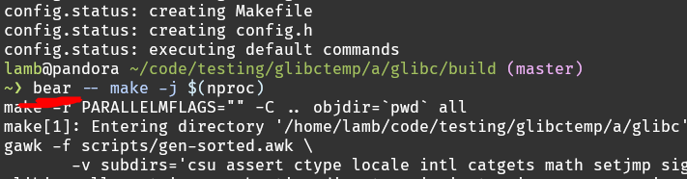
Compiling the standard library (glibc).
Add tag
Don’t use `bear –` again on an incremental build though!

Slide 24
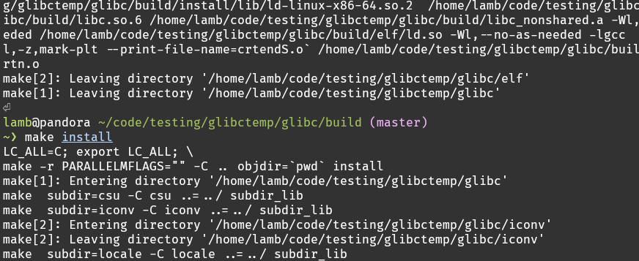
Compiling the standard library (glibc).
Add tag

Slide 25
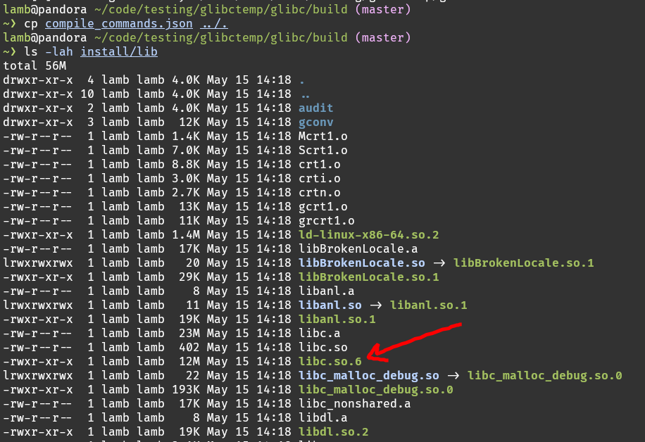
Compiling the standard library (glibc).
Add tag

Slide 26
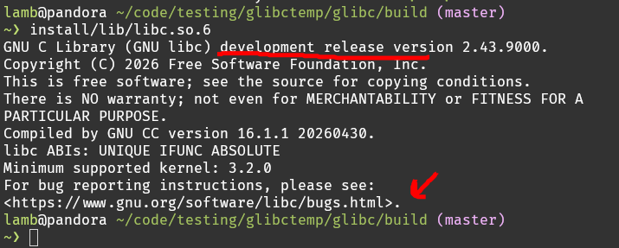

Compiling the standard library (glibc).
Add tag
Now clangd will work!

Slide 27
Reading the standard library.
Add tag
Why is this important?
For most pwn players, this will be the first (serious) (C) codebase they encounter.
How come?
Reading and understanding the malloc (malloc/malloc.c in glibc) implementation is necessary for heap exploitation (also quite fun!).
A particularly saucy part is that the malloc implementation can evolve throughout the lifetime of the library, so you need to know what version you should be looking at (*).

Slide 28
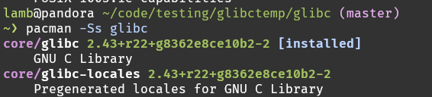
Wait why was the bug url different?
Add tag
Ah, distributions can carry their own patches..
How to see these patches? For arch linux, it’s pretty simple.
Sanity check the name of the package.

Slide 29
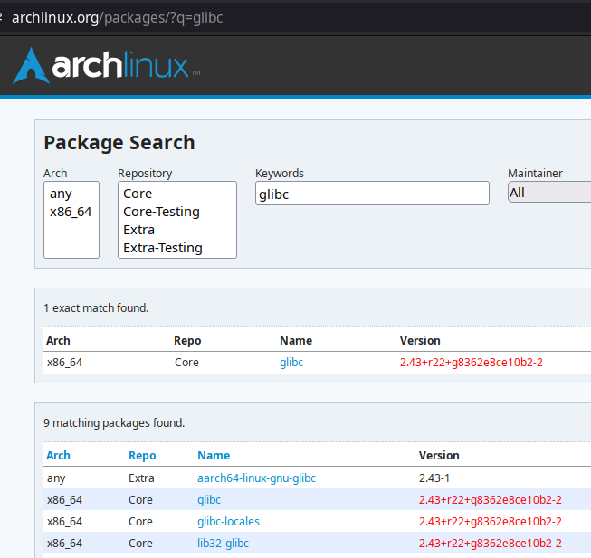
Wait why was the bug url different?
Add tag
2. Find the package on the arch package search (official packages != AUR (Arch User Repository))

Slide 30
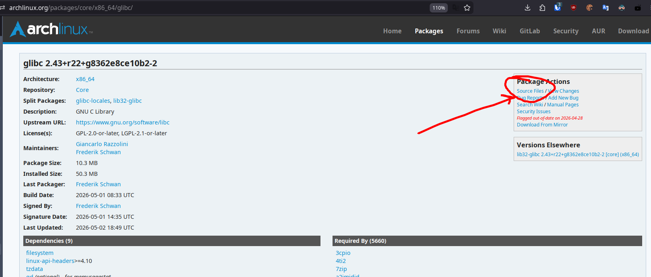
Wait why was the bug url different?
Add tag
3. Click on source files

Slide 31
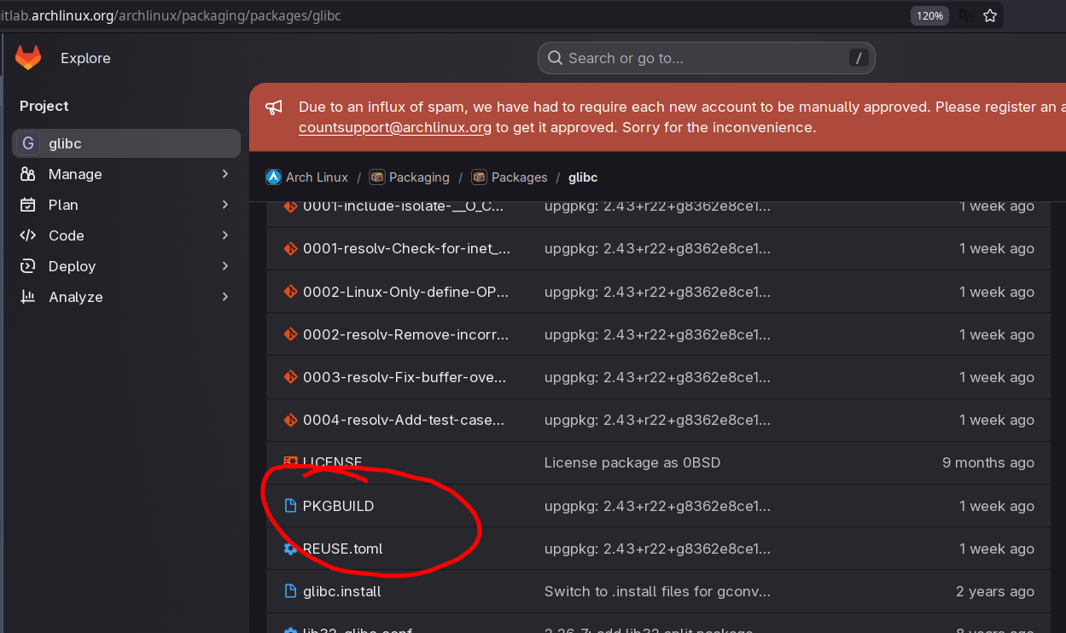
Wait why was the bug url different?
Add tag
4. Open the
PKGBUILD

Slide 32
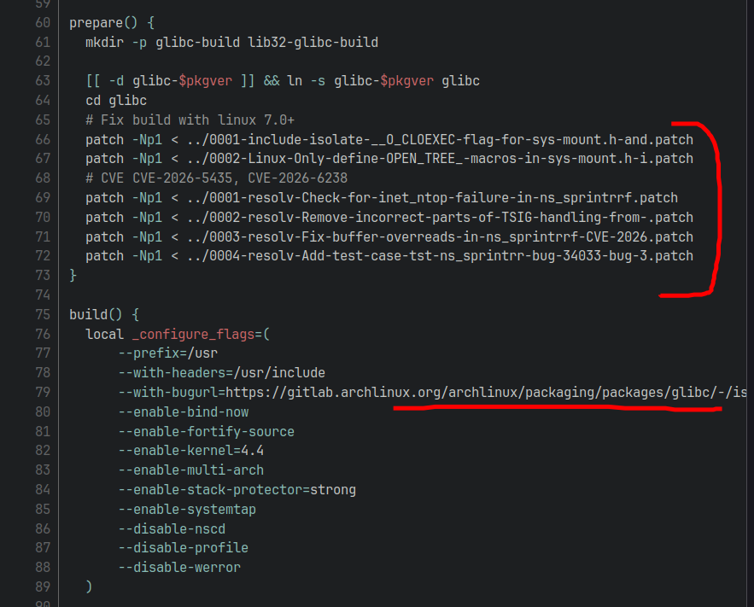
Wait why was the bug url different?
Add tag
We see all the patches, and that the bug url is actually a configure option.
Neat!
We can also use this to figure out the build instructions!

Slide 33
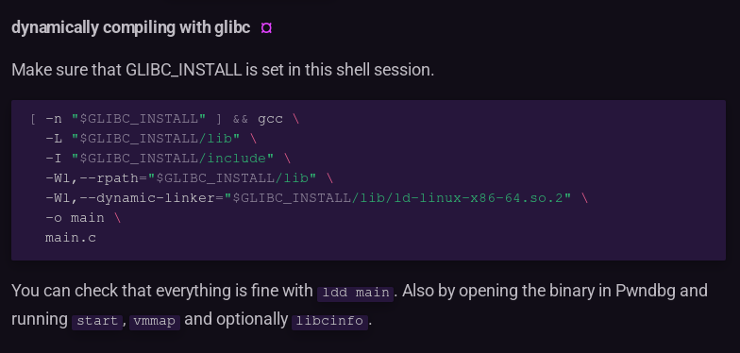
Compiling WITH glibc
Add tag
Compiling a program WITH the glibc that you compiled.
Same pwndbg doc page: https://pwndbg.re/dev/contributing/libc-provider/#dynamically-compiling-with-glibc .

Slide 34
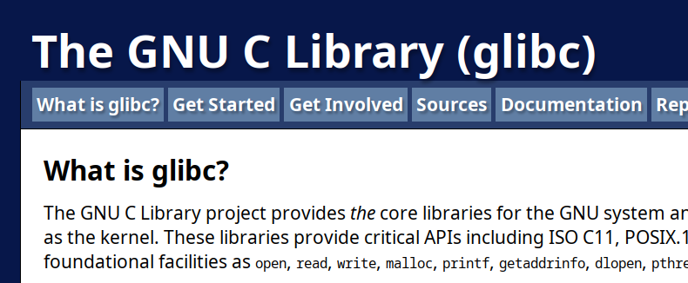
What libcs are out there?
Add tag
Glibc: https://sourceware.org/glibc/

Slide 35
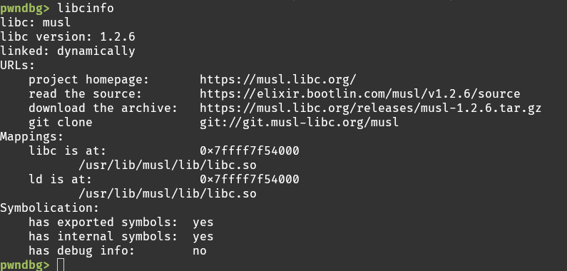
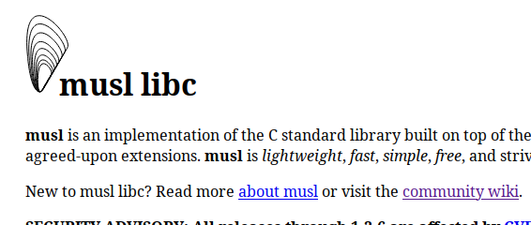
What libcs are out there?
Add tag
Musl: https://musl.libc.org/

Slide 36
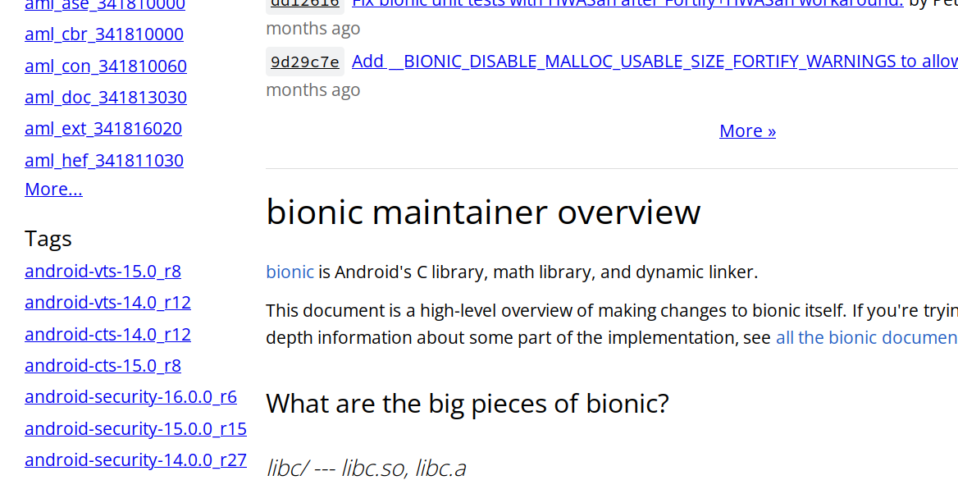
What libcs are out there?
Add tag
Bionic: https://android.googlesource.com/platform/bionic/

Slide 37
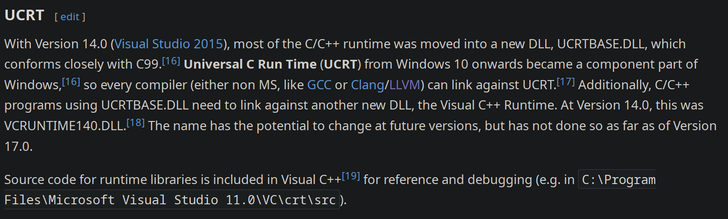
What libcs are out there?
Add tag
Microsoft Windows: https://en.wikipedia.org/wiki/Microsoft_Windows_library_files#CRT

Slide 38
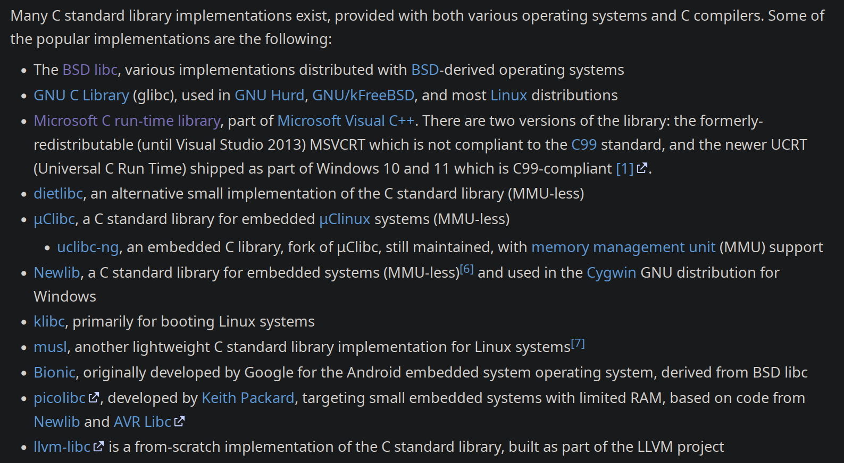
What libcs are out there?
Add tag
And many more!: https://en.wikipedia.org/wiki/C_standard_library#Implementations

Slide 39
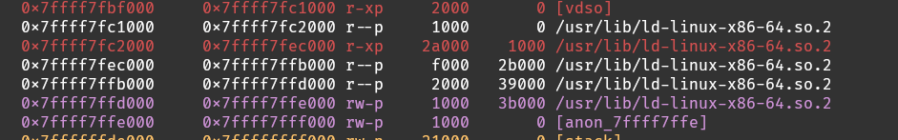
What is ld?
Add tag
The “ld” shared library is called the loader.
It does not provide library functions to programs, but rather does linking-related tasks at runtime like resolving function names, searching through loaded object files, bookkeeping for spawning and tearing down the process etc.
Some libc implementations combine these two shared libraries into one (musl), some hand it out as two different files (glibc). The source for both usually lives in the same repository. You need these to be matching in order to properly run a program.

Slide 40
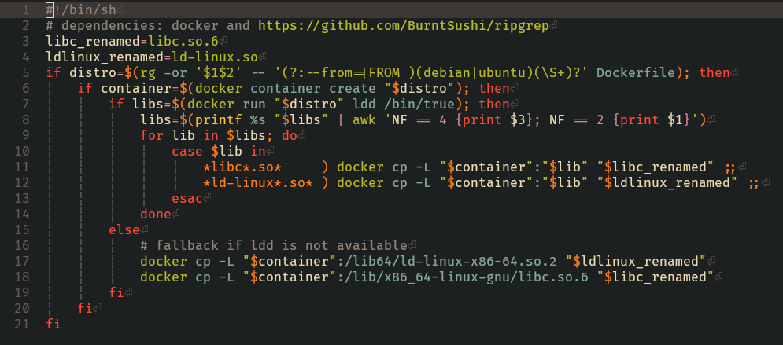
Libc setup in pwn
Add tag
Extract libc and ld from the dockerfile

Slide 41
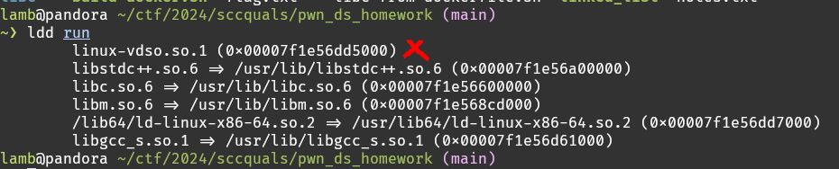
Libc setup in pwn
Add tag
Sometimes you’ll need to extract the files manually from the docker because there are extra deps like the C++ stdlib or maths/crypto libraries etc. (maybe could be automated?)
Use `ldd` to figure out the dependencies

Slide 42
Libc setup in pwn
Add tag
Sometimes you’ll need to extract the files manually from the docker because there are extra deps like the C++ stdlib or maths/crypto libraries etc. (maybe could be automated?)
Use `ldd` to figure out the dependencies
(ideally use ldd inside the docker)

Slide 43
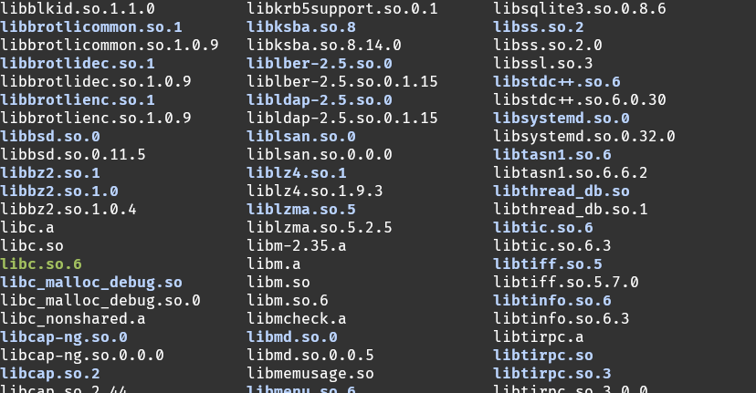
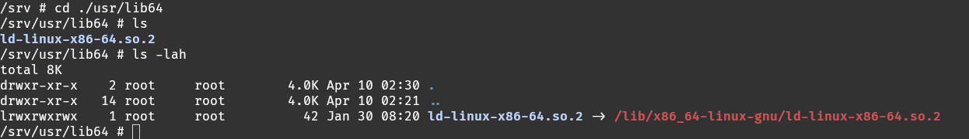
Libc setup in pwn
Add tag
On ubuntu-esque distributions you can usually find the libraries in `/usr/lib/x86_64-linux-gnu/`.

Slide 44
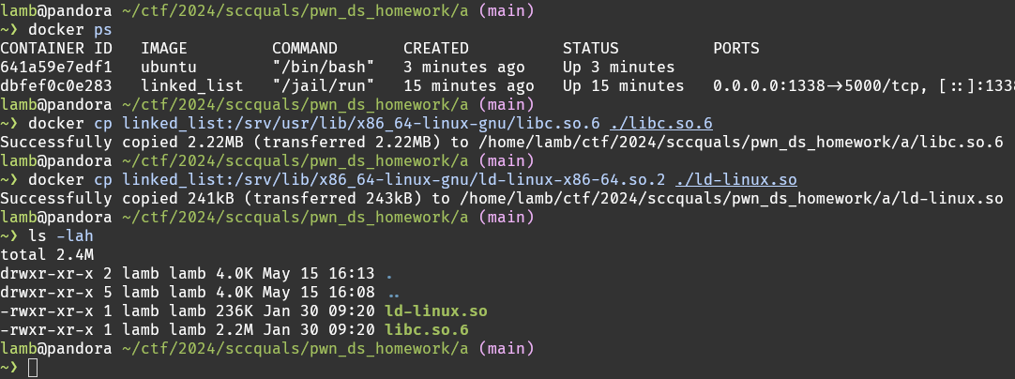
Libc setup in pwn
Add tag
Extract from docker manually.

Slide 45

Libc setup in pwn
Add tag
Patch the binary to use the libc and ld you extracted
https://github.com/io12/pwninit

Slide 46

Libc setup in pwn
Add tag
You should know how to do it manually!

Slide 47

Libc setup in pwn
Add tag
Sanity check: The paths are relative (and not absolute).

Slide 48

Libc setup in pwn
Add tag
The libc you extracted likely doesn’t have debug symbols, you want to symbolicate it. Couple of options:
Use pwntools
Use debuginfod (https://wiki.archlinux.org/title/Debuginfod)
Build the same version from source (might not have the same offsets, but is most convenient, and you can fix them later)
Let pwninit do it

Slide 49

Libc setup in pwn
Add tag
Getting the libc version: uber important!
Depends on the libc implementation, but usually `strings` works quite well.
Pwndbg also needs to do this, so you may check the source on how it does it:
https://github.com/pwndbg/pwndbg/blob/8273ec4a8760178d1bf565a980e55cbd798519b1/pwndbg/libc/musl.py#L58

Slide 50
Libc setup in pwn
Add tag
Getting the libc version: uber important!
Nowadays I don’t use these much, but it’s good to know that they exist:
https://libc.blukat.me/
https://libc.rip/
Can be useful if you need to figure out a glibc version without having access to the binary, but being able to do some leaks.

Slide 51
Add tag
Thanks

